Slide 1
Line Types
Object Lines
Hidden Lines
Center Lines
Phantom Lines
Dimension Lines
Extension Lines
Leader Lines
Cutting Plane Line
Sections - Hatching
Break Lines
thick
thin
thin
thin
thin
thick
thin
thick

Slide 2
Arrowheads
Arrowheads are used as terminators on dimension lines. The points of the arrowheads on leader lines and dimension lines must make contact with the feature object line or extension lines which represent the feature being dimensioned. The standard size ratio for all arrowheads on mechanical drawings is 3:1 (length to width).
200
R 8.5
Of the four different arrowhead types that are authorized by the national standard, ASME Y14.2M – 1994, a filled arrowhead is the highest preference.
1st
2nd
3rd
4th

Slide 3
Dimension Lines and Extension Lines
Extension lines overlap dimension lines (beyond the point of the arrowheads) by a distance of roughly 2-3mm
1.75
There should be a
visible gap (~1.5 mm)
between the object lines
and the beginning of
each extension line.
1.06
Dimensions should be placed outside the actual part outline. Dimensions should not be placed within the part boundaries unless greater clarity would result.

Slide 4
Placement of Linear Dimensions
Order of Preference
2.562
Arrows in / dimension in
1.250
Arrows out / dimension in
.750
Arrows in / dimension out
.500
Arrows out / dimension out
When there is not enough room between the extension lines to accommodate either the dimension value or the dimension lines they can be placed outside the extension lines.

Slide 5
Reference Dimensions
Reference Dimension Symbol (X.XXX)
EXAMPLE
Reference dimensions are used on drawings to provide support information only.
They are values that have been derived from other dimensions and therefore should not be used for calculation, production or inspection of parts.
The use of reference dimensions on drawings should be minimized.
2.250
1.000
(.750)
.500
.500
1.250
.500
(.750)

Slide 6
Location of Dimensions
Shorter (intermediate) dimensions are placed closest to the outline of the part, followed by dimensions of greater length. Dimensions nearest the object outline should be at least .375 inches (10 mm) away from the object, and succeeding parallel dimension lines should be at least .250 inches (6 mm) apart.
.250 (6mm)
Minimum Spacing
4.375
1.438
1.250
.375 (10mm)
Minimum Spacing
1.000
1.875
.688
1.062
2.312
Dimensions should be placed outside the actual part outline

Slide 7
Basic Dimensioning – Good Practice
4.375
1.438
1.250
1.000
1.875
.688
1.062
2.312
Extension lines should not cross dimension lines if avoidable
1.438
1.250
In-line dimensions can share arrowheads with contiguous dimensions
1.000
1.875
.688
1.062
2.312
BETTER
4.375

Slide 8
Diameter Dimensions
Holes and cutouts
1.375
.625 THRU
.250
.62
.250
x .62 DP
1.375

Slide 9
Diameter Dimensions
Shafts and Holes
Whenever it is practical to do so, external diameters are dimensioned in rectangular (or longitudinal) views. Cylindrical holes, slotted holes, and cutouts that are irregular in shape would normally be dimensioned in views where their true geometric shape is shown.
.25 THRU
1.25
.75
2.00

Slide 10
Placement with Polar Coordinates
To dimension features on a round or axisymmetric component
18º
18º
3X .562
6X .188
3.50
.875
18º
18º
18º
18º

Slide 11
Radial Dimensions
To indicate the size of fillets, rounds, and radii
R.312
R14.25
R.750
R.312
R.562

Slide 12
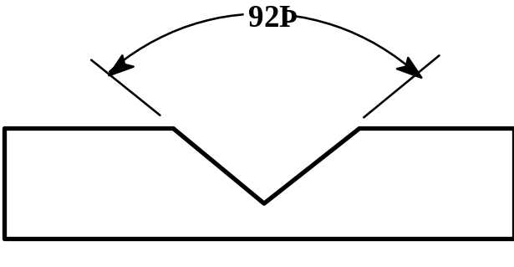
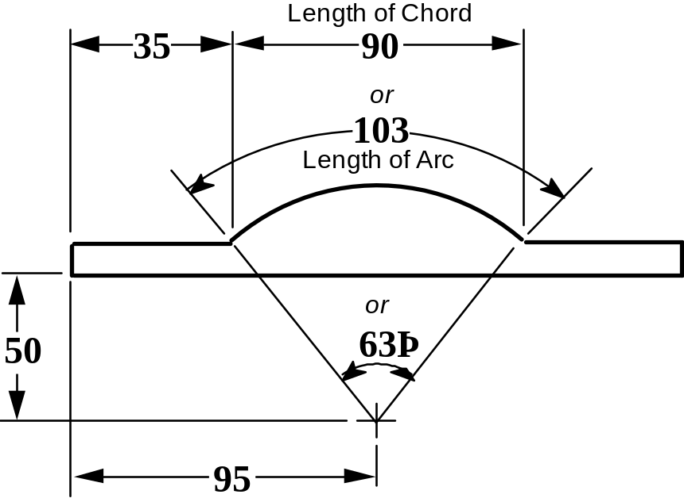
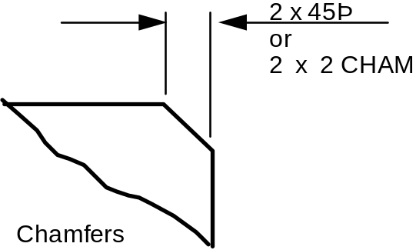
Angular Dimensions:
To indicate the size of angular details appearing as either angular or linear dimensions.
92º
2 x 45º
63º
Alternate

